Slide 1
Unlocking Python's Dictionary Power
Dive deeper into Python dictionaries: from handling hashable keys and efficiently accumulating data to optimizing functions with memoization and mastering debugging techniques for large datasets.

Slide 2

CHAPTER HIGHLIGHT
The Essence of Dictionaries: Keys, Values & Hashability
Mutable vs. Immutable Keys
Why Hashable Keys?
Python dictionaries are powerful, mapping keys to values. While values can be any data type, keys have a crucial constraint: they must be immutable (hashable).
Dictionaries rely on hash tables for efficient data storage and retrieval. A hash function takes a key and generates an integer (its hash value). This value helps quickly locate where the key-value pair is stored.
Valid Keys: Integers, floats, strings, and tuples (if all their elements are immutable).
Invalid Keys: Lists and other mutable types cannot be dictionary keys. Why? Because their content can change, which would alter their hash value.
If a key were mutable, its hash value could change, making it impossible for the dictionary to reliably find the stored value. This is why mutability and hashability are mutually exclusive for dictionary keys.

Slide 3




PROGRAMMING PATTERNS
Accumulators: Building Data Through Iteration
Accumulators are variables used within loops to collect or aggregate data, transforming raw input into structured output.
1. Initialization
2. Iteration & Condition
Begin by initializing an empty accumulator (e.g., an empty list or a counter set to zero) before entering the loop.
Inside the loop, process each item. Apply a condition to determine if the item should be added to the accumulator.
3. Accumulation
4. Result
If the condition is met, update the accumulator (e.g., append to a list, increment a counter).
After the loop completes, the accumulator holds the final, aggregated result.
Example: Filtering Palindromes
To build a list of palindromes from a dictionary of words, you initialize an empty list palindromes = []. Within the loop, if a word is_palindrome(word), you palindromes.append(word). The final palindromes list holds all the matched words.

Slide 4
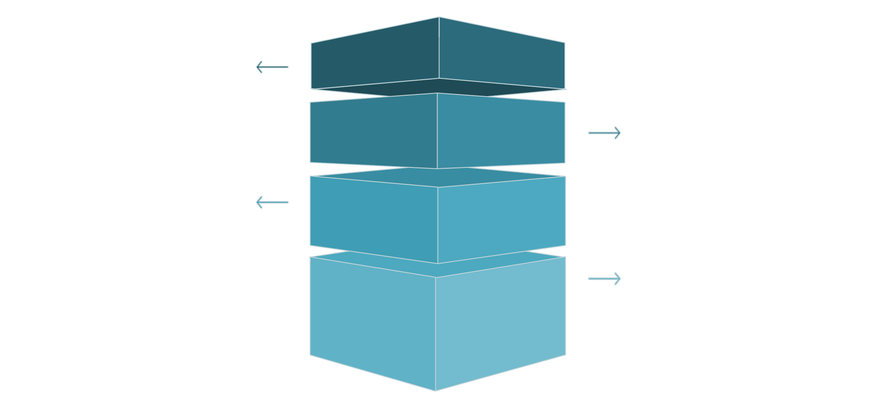
OPTIMIZATION TECHNIQUE
Memoization: Boosting Performance with Stored Results
Memoization is an optimization technique where you store the results of expensive function calls and return the cached result when the same inputs occur again. This dramatically speeds up functions that recompute the same values many times.
The Problem: Recursive Inefficiency
Consider the classic Fibonacci sequence: fibonacci(n-1) + fibonacci(n-2). Without memoization, functions like fibonacci(4) repeatedly calculate fibonacci(2) and fibonacci(1), leading to exponential runtime as 'n' grows.
Root Call
fibonacci(3) splits into two calls.
First Branch
fibonacci(2) calls fibonacci(1) and fibonacci(0).
Second Branch
Another fibonacci(2) repeats fibonacci(1) and fibonacci(0).
Base Results
fibonacci(1)=1 and fibonacci(0)=0 returned.
The Solution: A Memoized Approach
By storing computed Fibonacci numbers in a dictionary, fibonacci_memo avoids redundant calculations. For example, fibonacci_memo(40) can execute millions of times faster than its non-memoized counterpart.
known Dictionary: Stores {0:0, 1:1} initially.
Check Cache: Before computing, check known. If n is found, return known[n].
Compute & Store: If not found, compute the value, store it in known[n], then return it.

Slide 5

BEST PRACTICES
Debugging Strategies for Large Datasets
Effective debugging is crucial when working with extensive datasets. These strategies help streamline the process and pinpoint issues efficiently.
Scale Down Input
Reduce the dataset size (e.g., process only the first 10 lines of a file) to isolate the smallest case that triggers an error. Gradually increase the size as bugs are resolved.
Check Summaries & Types
Instead of printing entire datasets, print summaries (e.g., dictionary item counts, list totals) or check variable types to quickly identify unexpected values or mismatches.
Implement Self-Checks
Automate error detection with "sanity checks" (e.g., ensuring a calculated average falls within expected bounds) and "consistency checks" (comparing results from different computations).
Format Output
Use tools like the pprint module to display data in a more readable format, making it easier to spot discrepancies and errors.
"Time spent building scaffolding can reduce the time you spend debugging."

